Slide 1
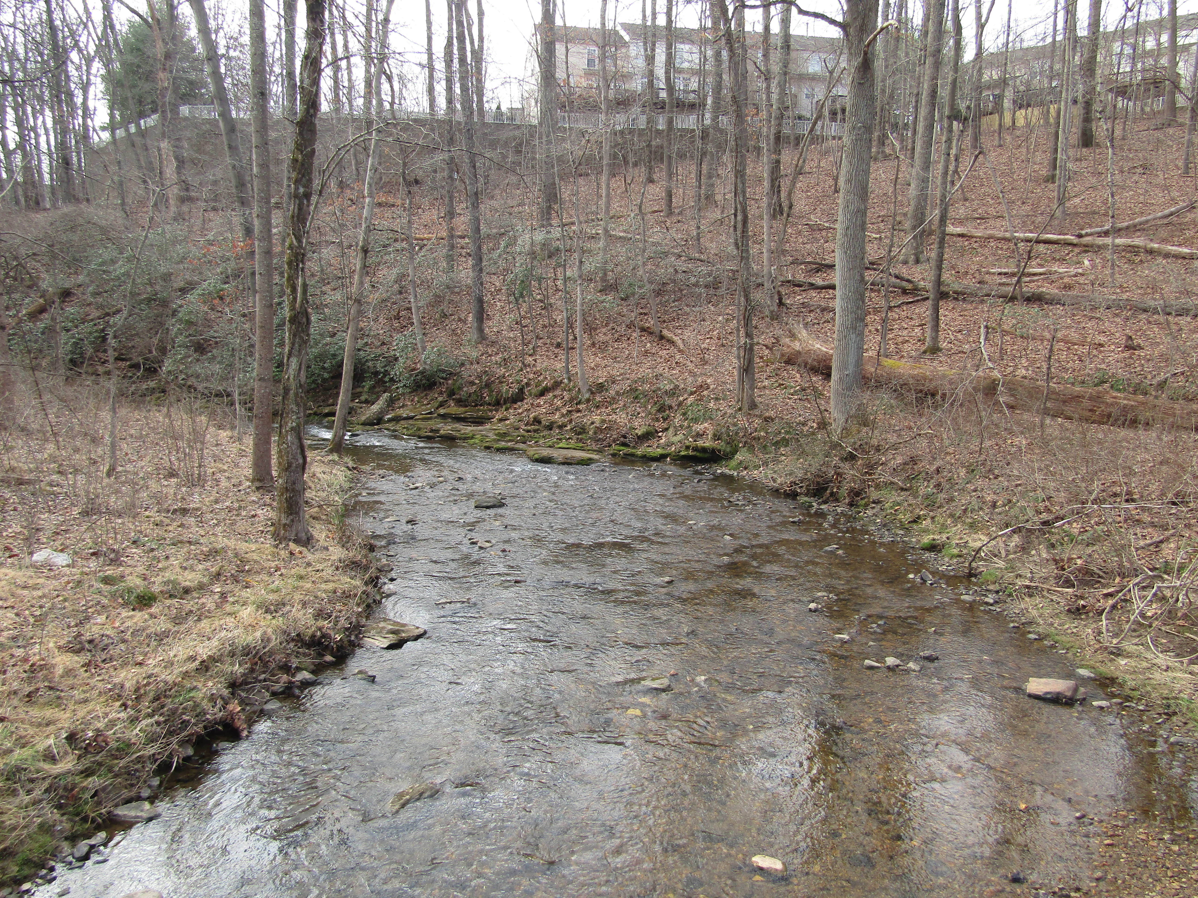
Can a Maryland Piedmont Trout Stream Be Protected From Rapid Urban Development? The Long-Term View
Nguyen Tien Anh Quach and Susan Gresens
Department of Biological Sciences
Towson University

Slide 2
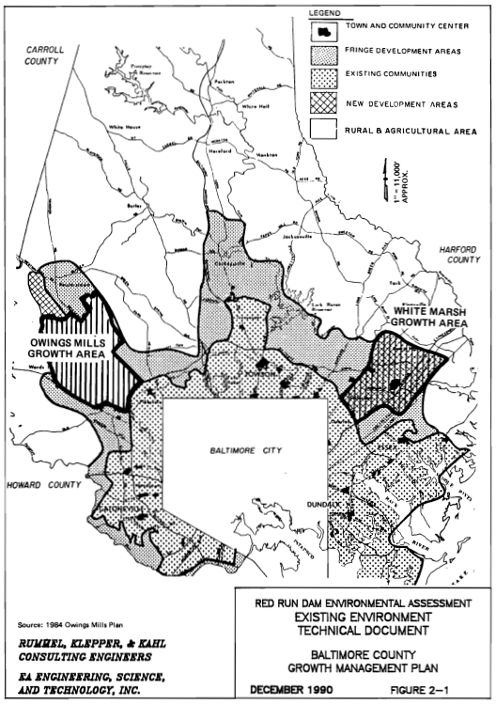
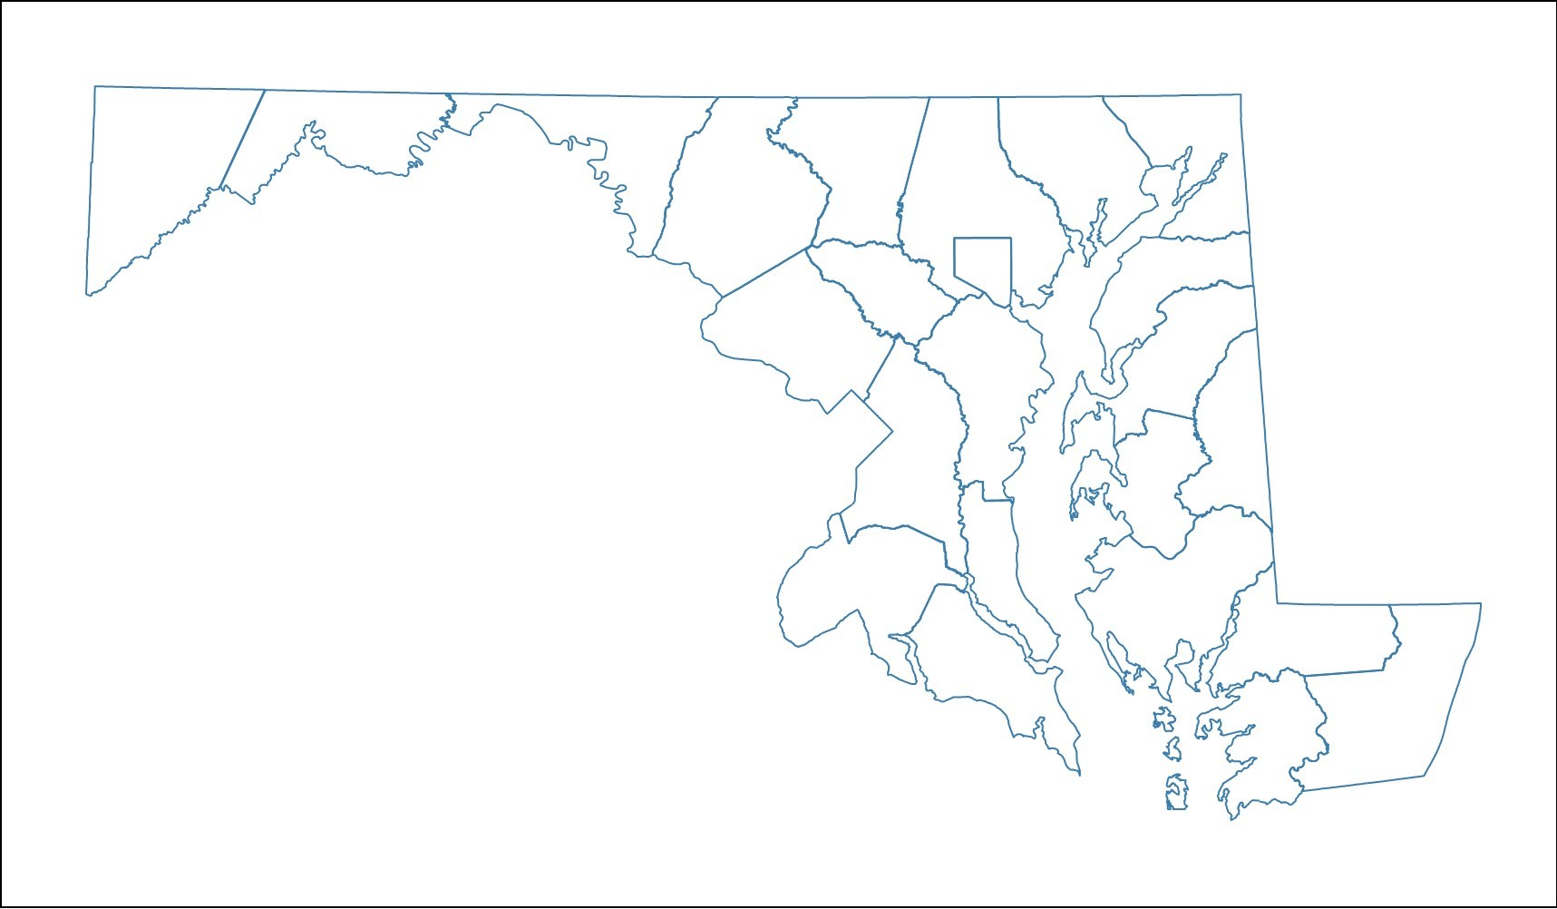
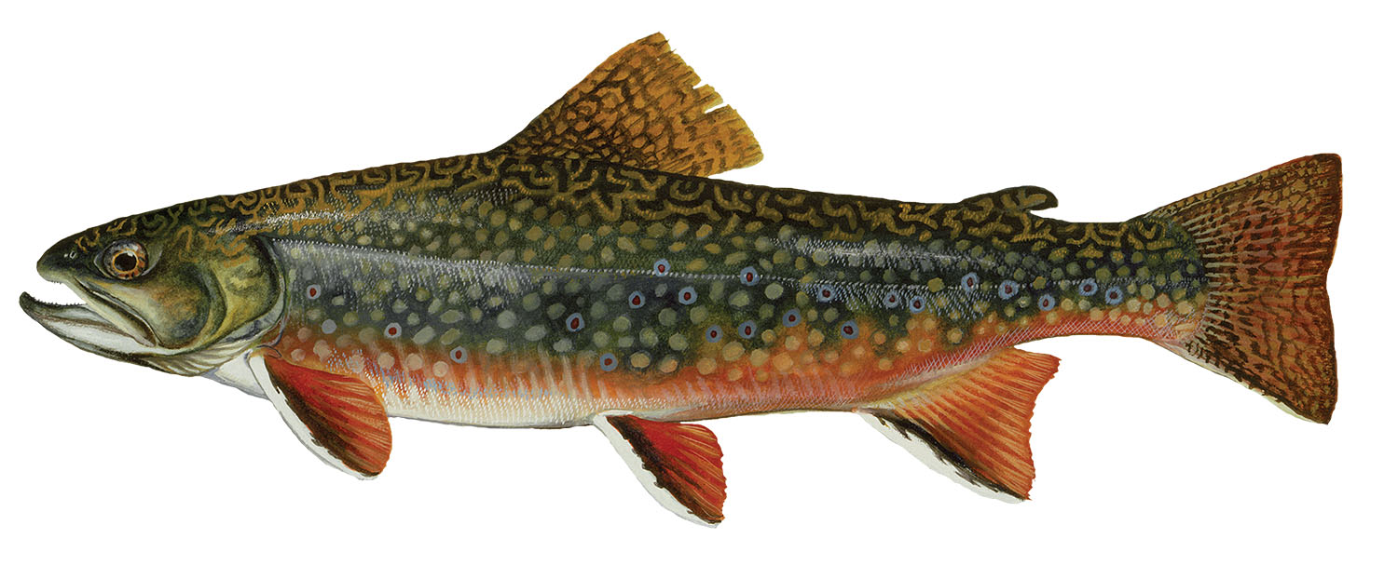
Baltimore County, MD
1979: County Council adopted a 20-year plan
Owings Mills Town Center
Red Run Dam
1990: Technical Report
Vol 1/2/3
Maryland
Notes:
Tell a story!
Red Run dam
Owings Mills cluster development: https://www.baltimorecountymd.gov/departments/economicdev/meet-baltimore-county/business-communities/owingsmills.html
The county was trying to manage growth by creating two town centers, including Owings Mills
Construct a regional flood control/stormwater management facility in RR watershed, where growth will occur
=> Basis for 1990 bioassessment

Slide 3
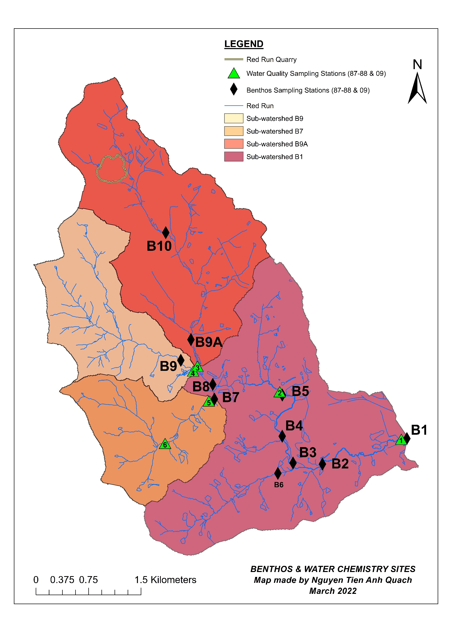
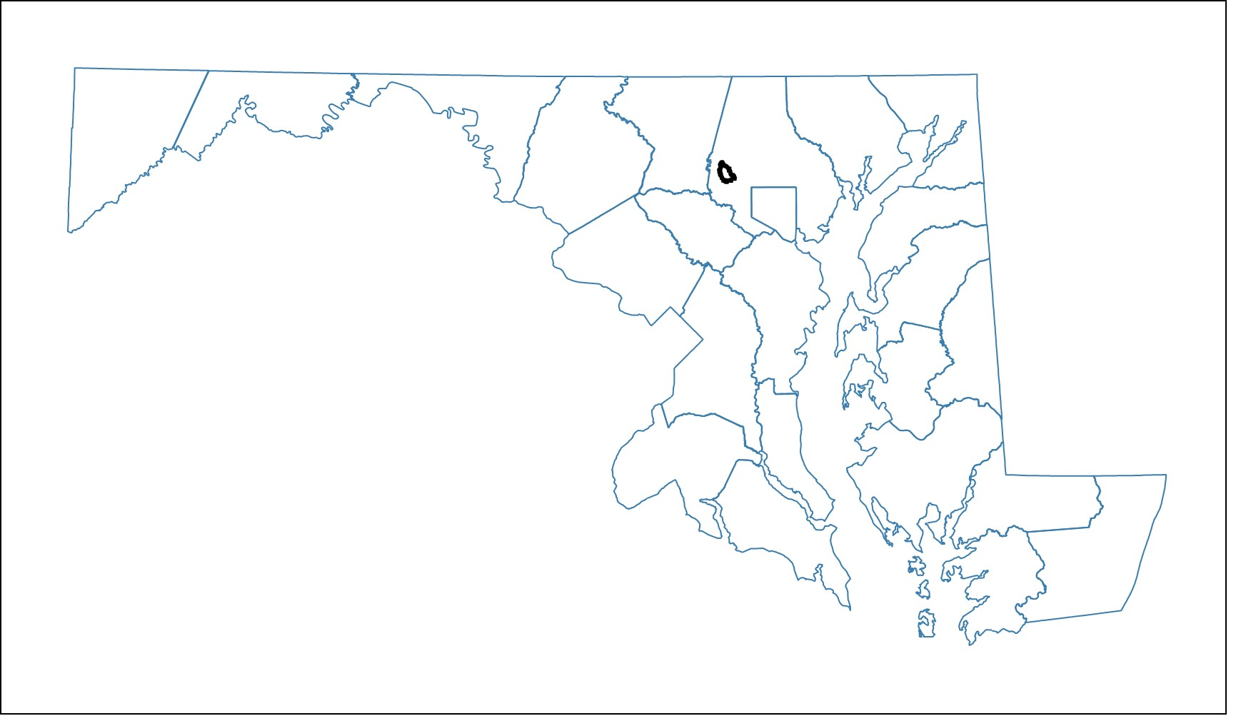
Maryland
Sub-watershed | Number of benthic sampling stations | Number of water quality sampling stations
B9 | 1 | 1
B7 | 1 | 2
B9A | 2 | 1
B1 | 6 | 2
Notes:
Image of MD and RR showing benthic and water quality sampling sites
1990 Report finding about brook trout.
2009 Repeated Sampling: Hess
Water quality sampling: Same stations.
=> Importance of the study: Before and After; paired design

Slide 4
Research Questions
How did (a) land cover and (b) water chemistry change over the period 1987-2009?
How did benthic macroinvertebrate communities respond to rapid urban development?
Was there evidence of which stressor(s) caused benthic decline? (a) a combination of multiple urban stressors or (b) salinity?

Slide 5
Results

Slide 6
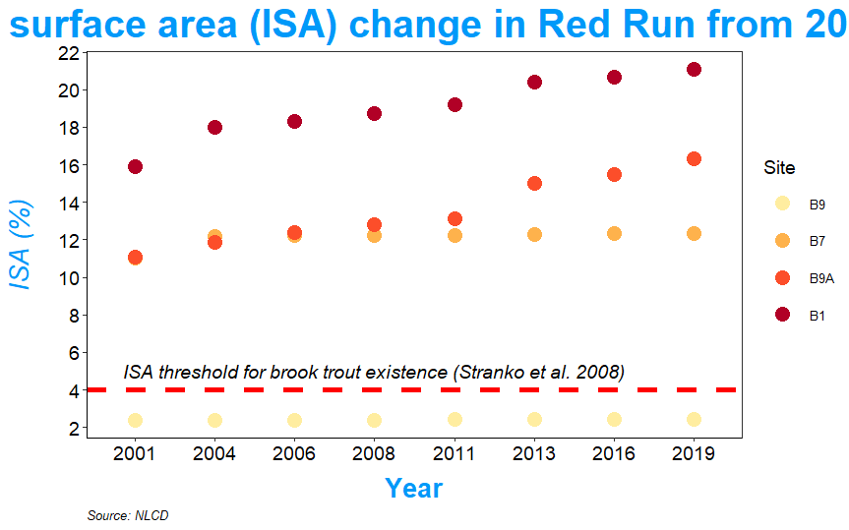
1a. Increase in % ISA varied greatly among the four sub-watersheds
Percentage of impervious surface area (ISA)
in Red Run from 2001 to 2019

Slide 7
Percentage of impervious surface area (ISA)
in Red Run from 2001 to 2019

Slide 8
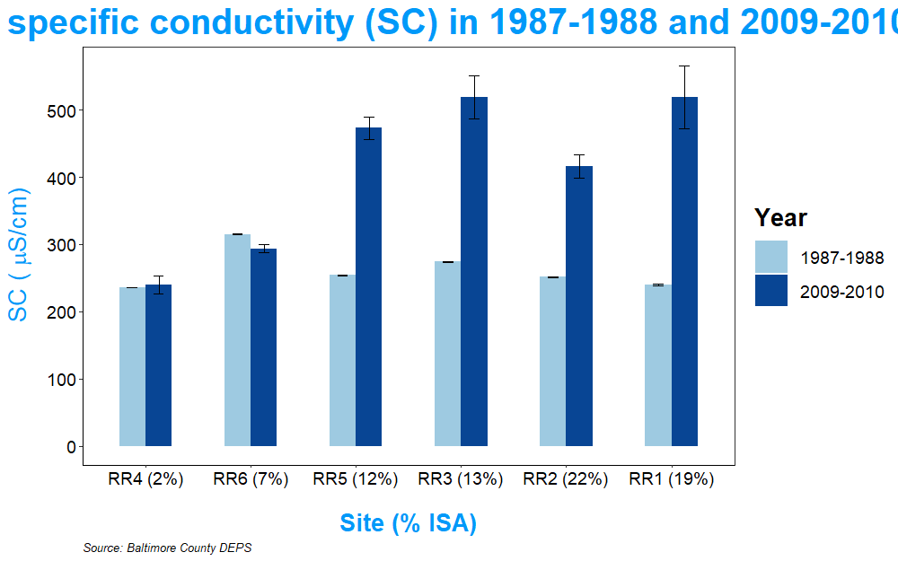
1b. Increases in SC and conc. of Cl⁻ and Ca²⁺ in sub-watersheds with high % ISA.
Mean specific conductivity (SC)
N₁₉₈₇ = 11
N₂₀₀₉ = 10
No change in pH, water temperature, and DO
Significant correlations between:
Cl⁻ and Ca²⁺ (R² = 0.93; p < 0.001)
Cl⁻ and SC (R² = 0.91; p < 0.001)
Ca²⁺ and SC (R² = 0.83; p < 0.001)

Slide 9
* Absolute change = 2009 metric value – 1987 metric value
Site | Hess sampler – Spring Index Period | Change in benthic metrics
Sub-watershed | Change in number of taxa | Change in number of EPT taxa | Change in number of Ephemeroptera taxa | Change in percent urban intolerant taxa | Change in percent Chironomidae
B9 | 10 | 8 | 1 | -11% | 4%
B7 | -4 | -6 | -3 | -56% | 34%
B9A | -7 | -8 | -3 | -27% | 15%
B1 | 10 | 1 | 0 | 1% | -30%
Notes:
DIFF = 1987-2009
Only Spring data were used to compared since the protocol is to sample in the Spring.

Slide 10
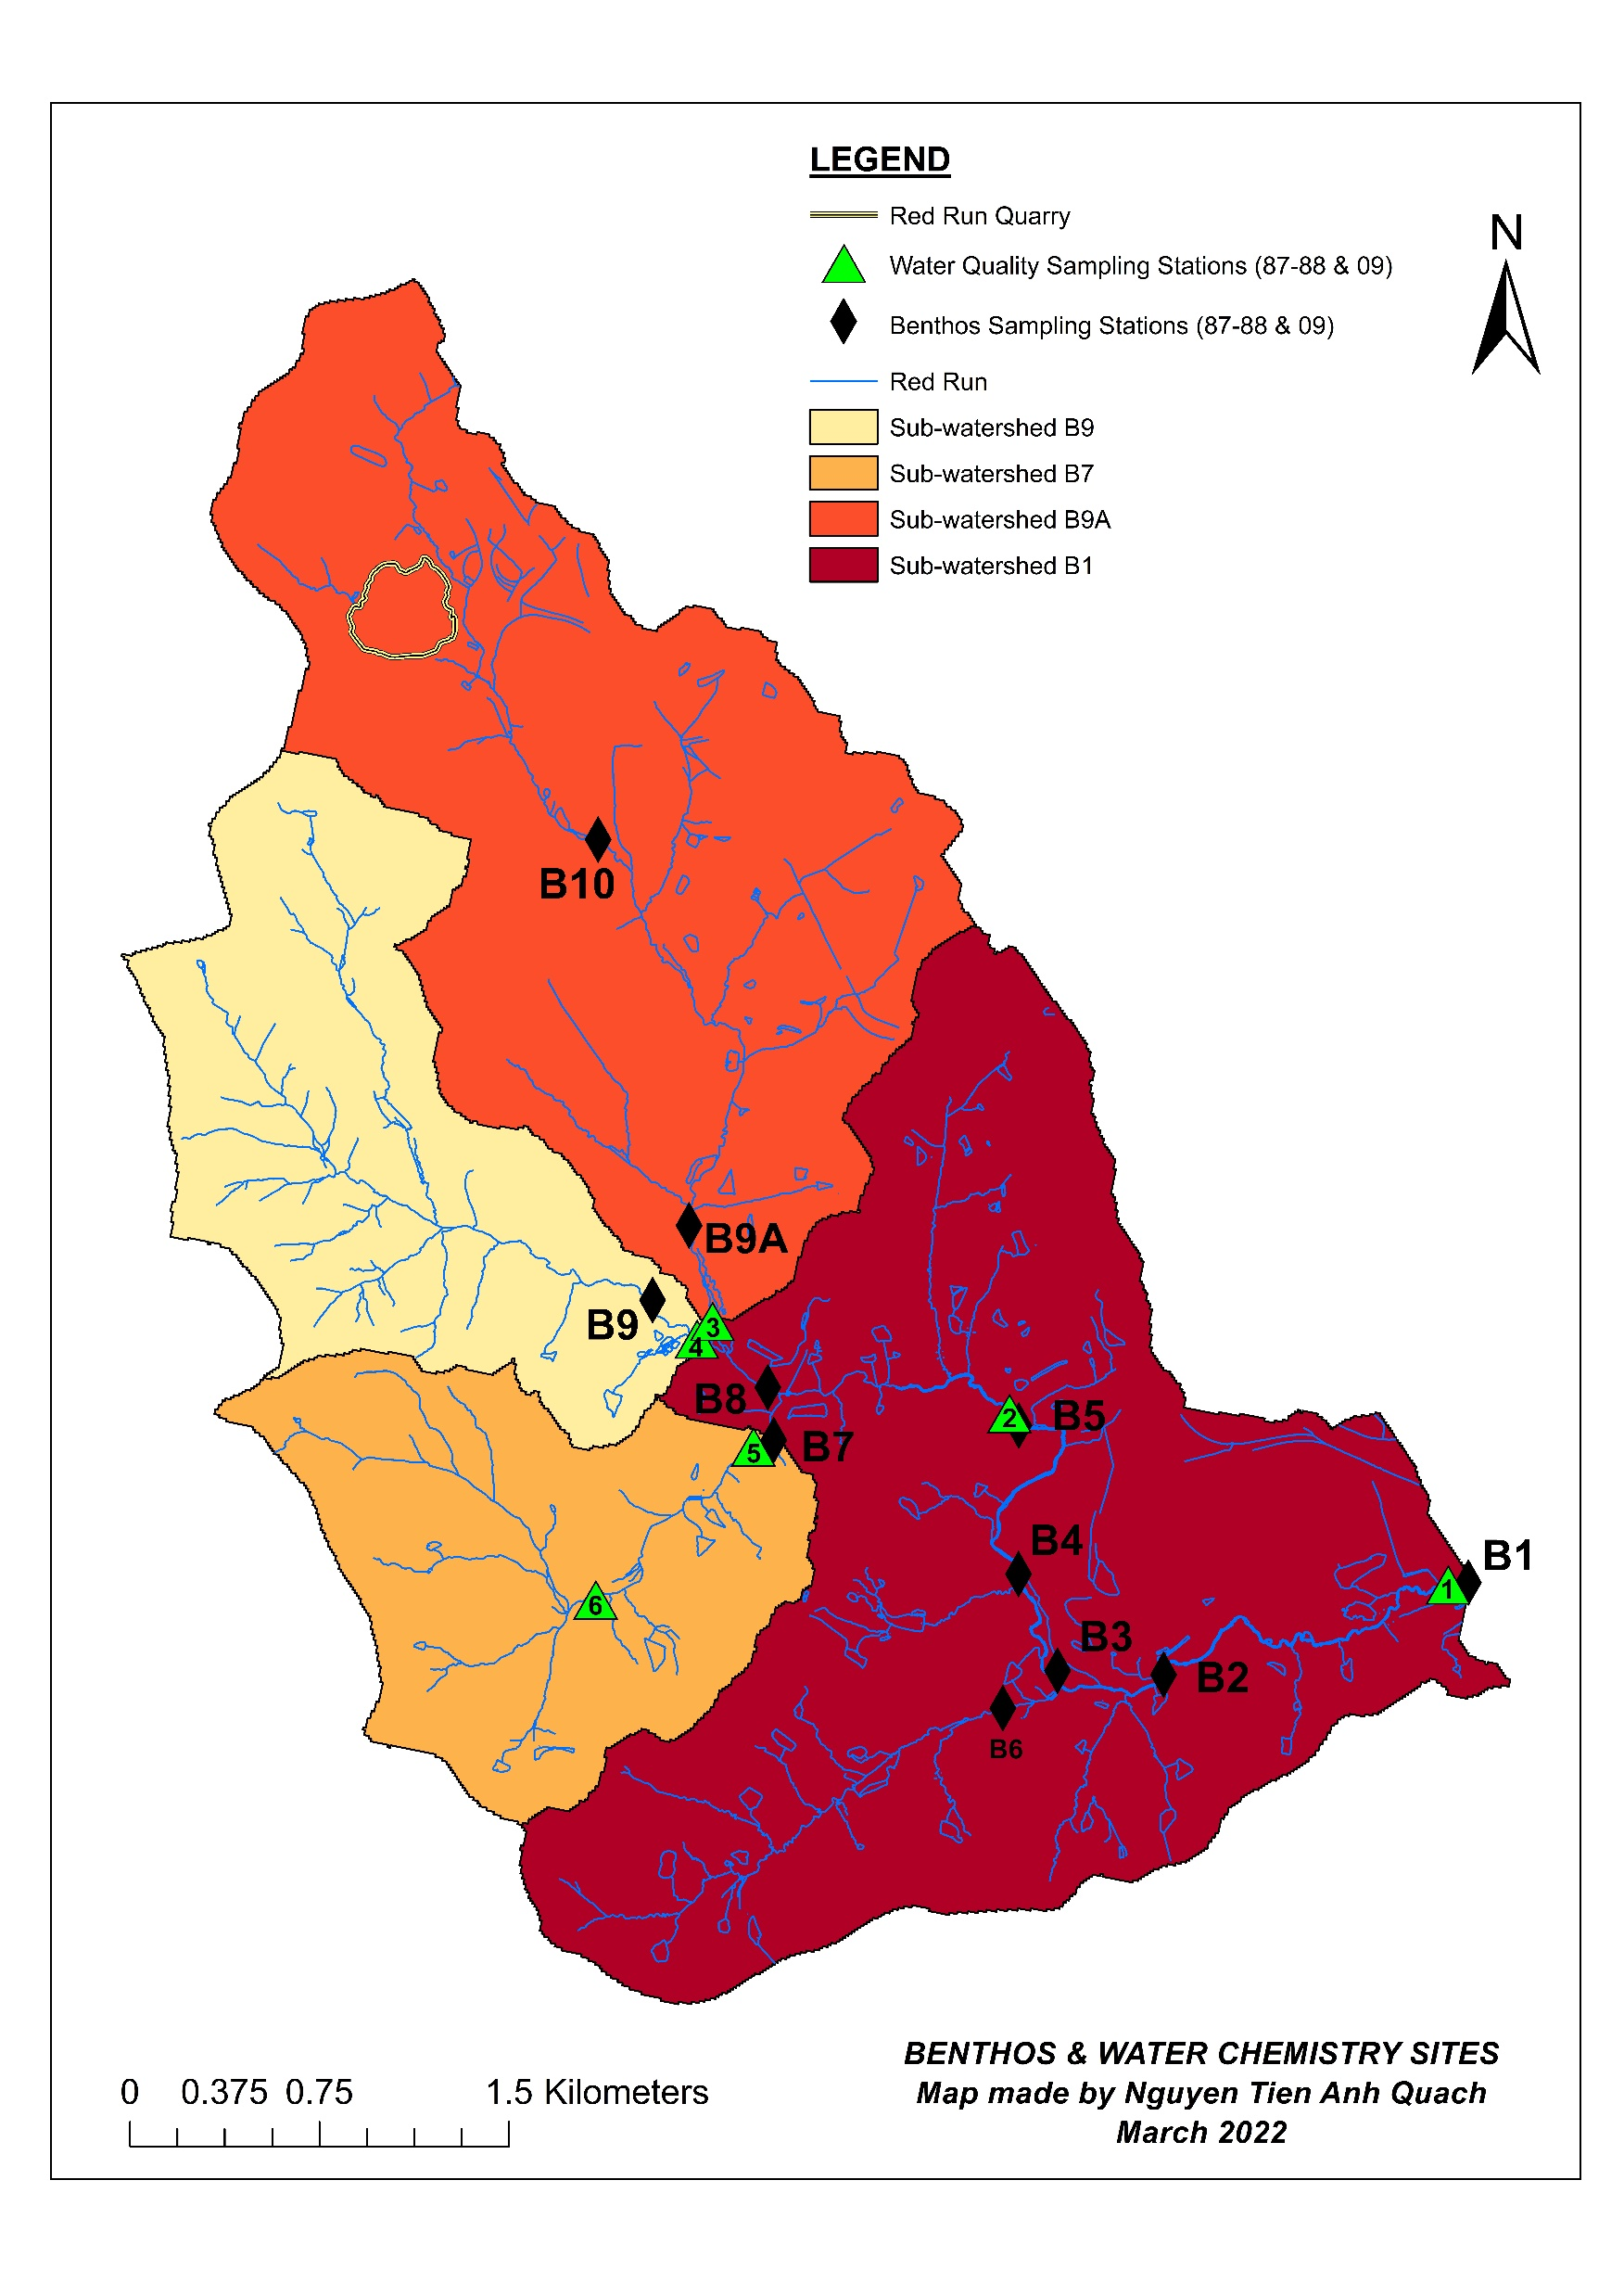
Notes:
DIFF = 1987-2009
Only Spring data were used to compared since the protocol is to sample in the Spring.

Slide 11
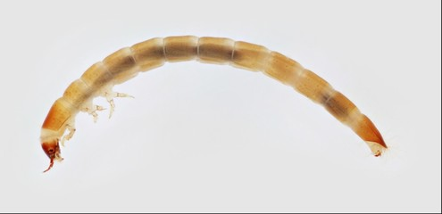
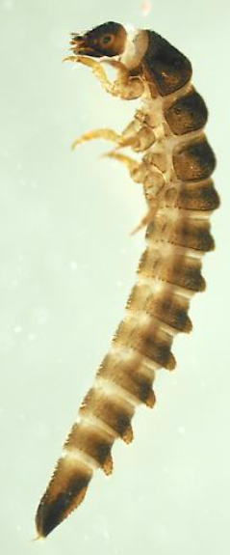
B9
Notes:
DIFF = 1987-2009
Only Spring data were used to compared since the protocol is to sample in the Spring.

Slide 12
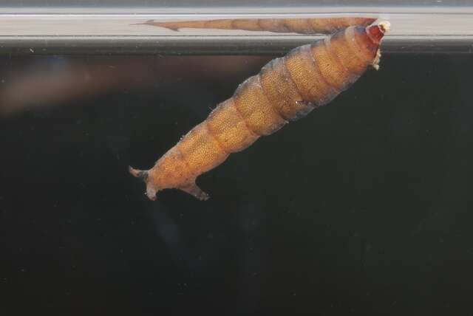
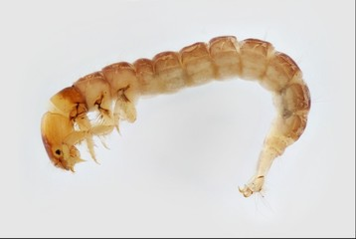
B7
Notes:
DIFF = 1987-2009
Only Spring data were used to compared since the protocol is to sample in the Spring.

Slide 13
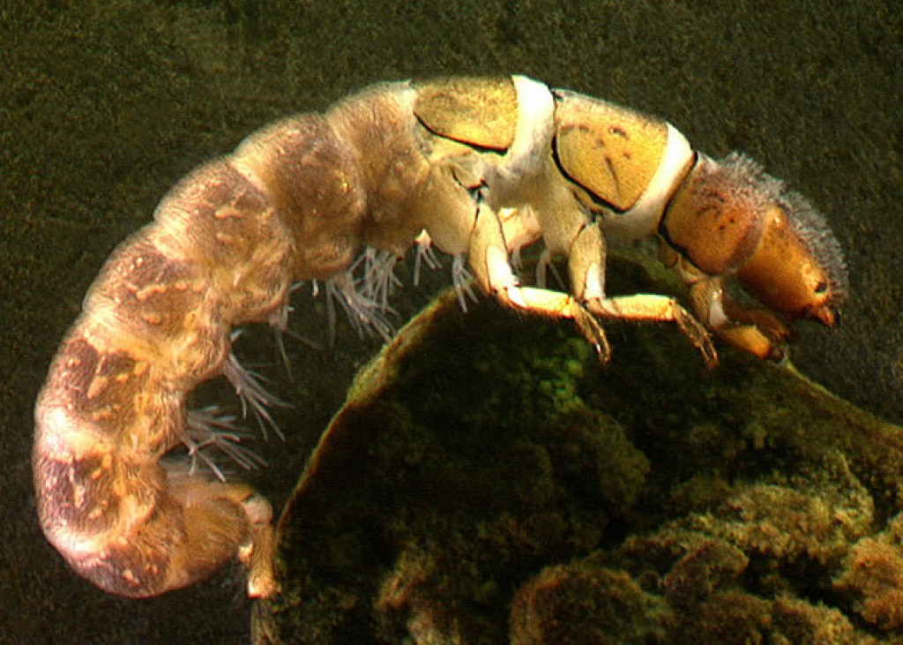
s
s
s
B9A & B10
s
s
Notes:
DIFF = 1987-2009
Only Spring data were used to compared since the protocol is to sample in the Spring.

Slide 14
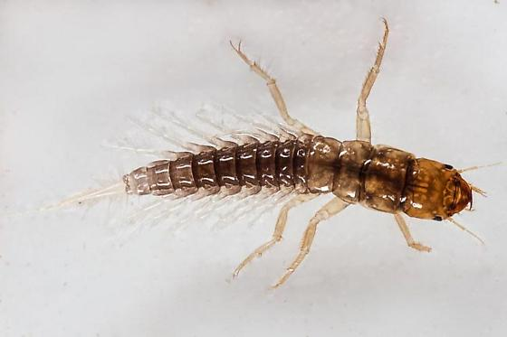
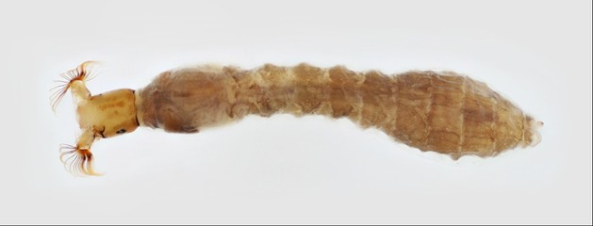
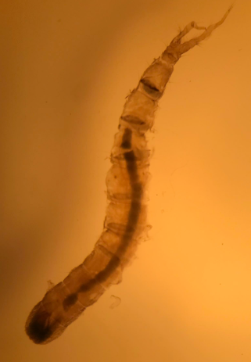
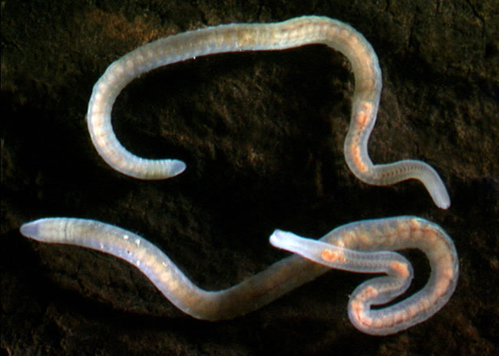
2. Predictable changes in benthic communities among sub-watersheds.
Downstream, mainstem
Notes:
B9.87: Promoresia; B7.87: Nyctiophylax; B1, 2, etc: Oligochaeta and Prosimulium and Sialis;
B1, 2, etc 2009: Antocha and Hemerodromia; B7: Limnophora; B9: Anchytarsus; B9A B10: Diplectrona

Slide 15
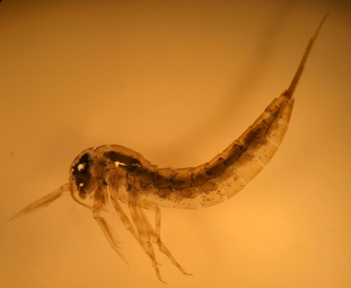

3a. Urban stressors: Are mean tolerance values of “disappeared” taxa significantly lower than those of randomly lost taxa?
Tolerance Value (Southerland et al. 2005)
* Urban-intolerant taxa are intolerant to pollution and have tolerance values $≤$ 3 (out of 10)
Isonychia (Ephemeroptera)
Antocha (Tipulidae)
Notes:
Hypotheses:
Null hypothesis: Taxa were lost totally due to random chance.
A priori/alternative hypothesis: Based on changes in land cover and water chemistry, urban intolerant taxa were lost.
Tool used: Randomization test
Test statistic: Mean tolerance value of lost taxa
Results: At B1, B2, and B7, null hypothesis rejected.

Slide 16
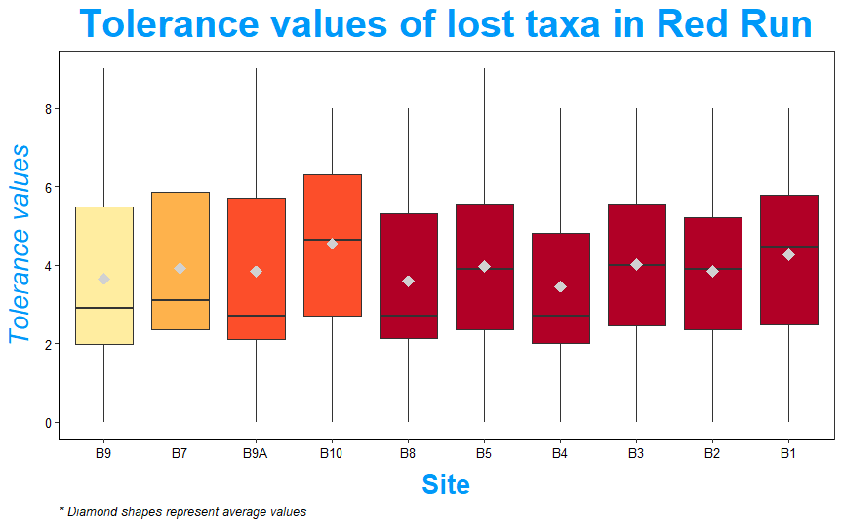
*
*
*
3a. There were evidences of urban stressors on “disappeared” taxa

Slide 17
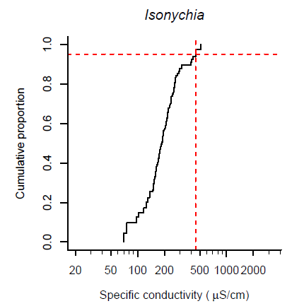
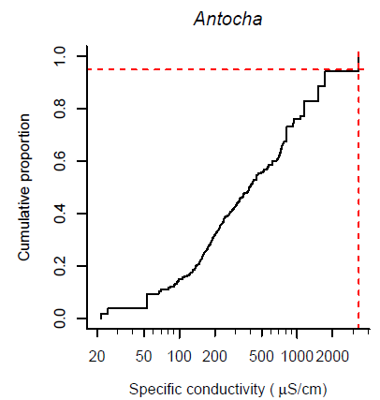
XC₉₅ (Cormier et al., 2018)
Cormier, S. M., Zheng, L., & Flaherty, C. M. (2018). A field-based model of the relationship between extirpation of salt-intolerant benthic invertebrates and background conductivity. Science of The Total Environment, 633, 1629–1636. https://doi.org/10.1016/j.scitotenv.2018.02.044
Notes:
DIFF = 1987-2009
Only Spring data were used to compared since the protocol is to sample in the Spring.

Slide 18
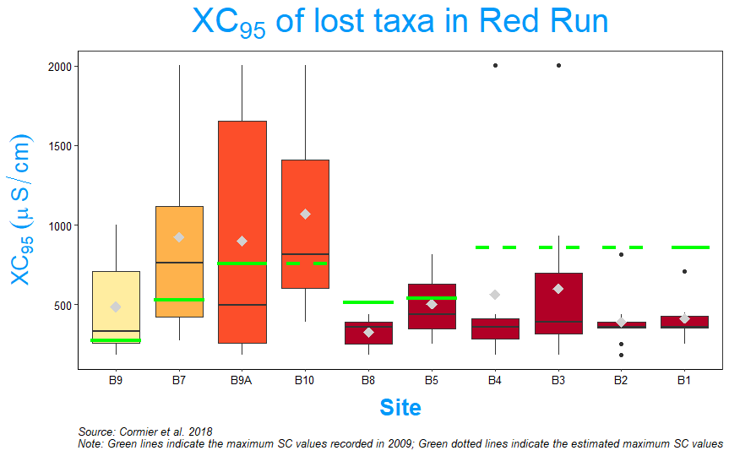
*
*
*
3b. There were evidences of a salinity stressor on “disappeared” taxa
Notes:
DIFF = 1987-2009
Only Spring data were used to compared since the protocol is to sample in the Spring.

Slide 19
Conclusion

Slide 20
Conclusion
Increases in ISA and SC (also Cl⁻ and Ca²⁺) with great variations among sub-watersheds.
Decreases in number of taxa, EPT taxa and percentage of urban intolerant taxa.
Salt (deicers) was a potential driving cause of benthic declines.

Slide 21
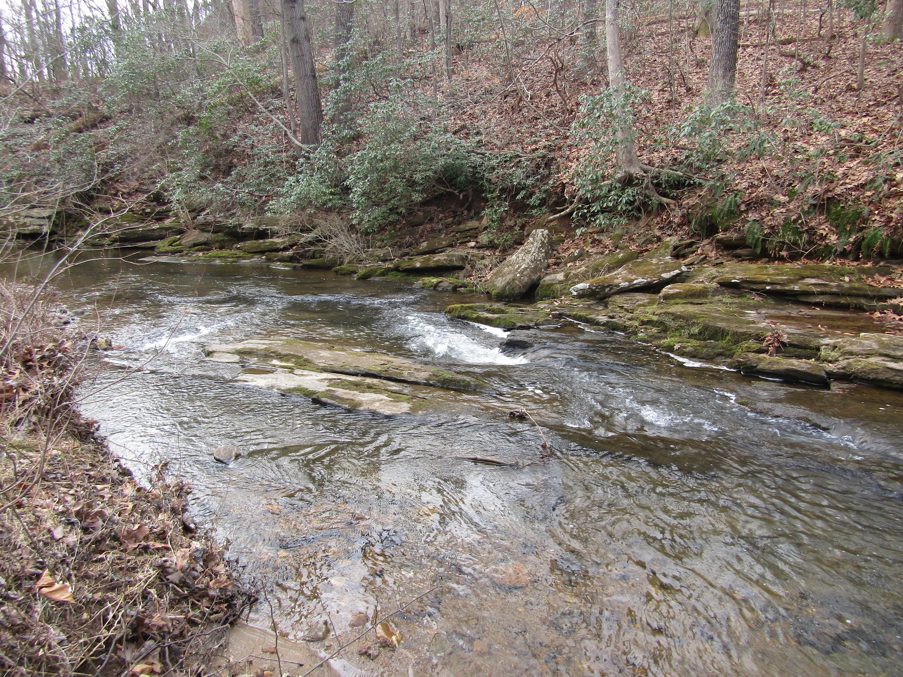
THANK YOU!

